Slide 1
Course Introduction
2019 / 9 / 23
Slides adapted from Berkeley CS61a

Slide 2
What is Computer Science?
What problems can be solved using computation?
How to solve those problems?
What techniques lead to effective solutions?

Slide 3
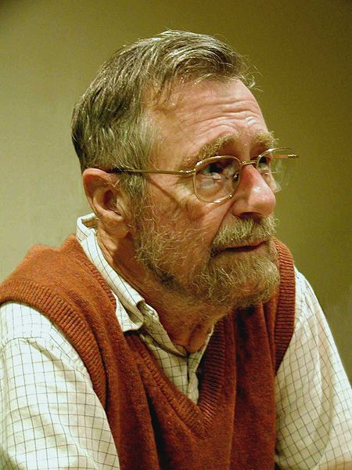
What is Computer Science?
Systems
Artificial Intelligence
Graphics
Security
Networking
Programming Languages
Theory
Scientific Computing
...
Computer Science is no more about computers than astronomy is about telescopes.
Edsger W. Dijkstra

Slide 4
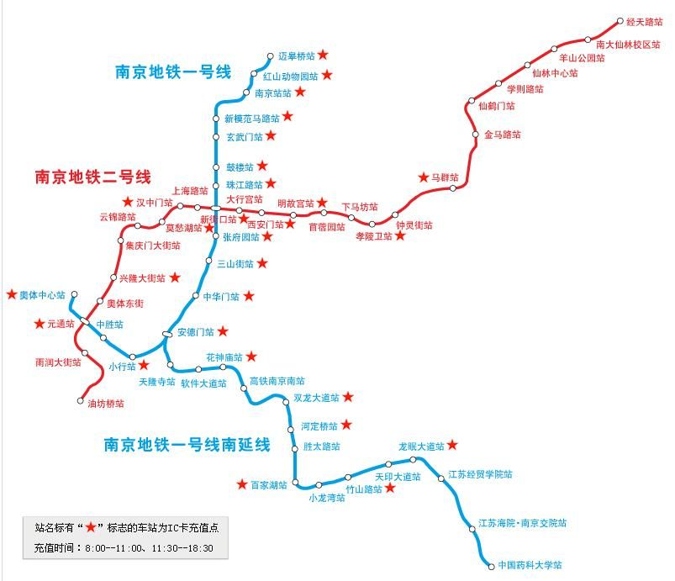
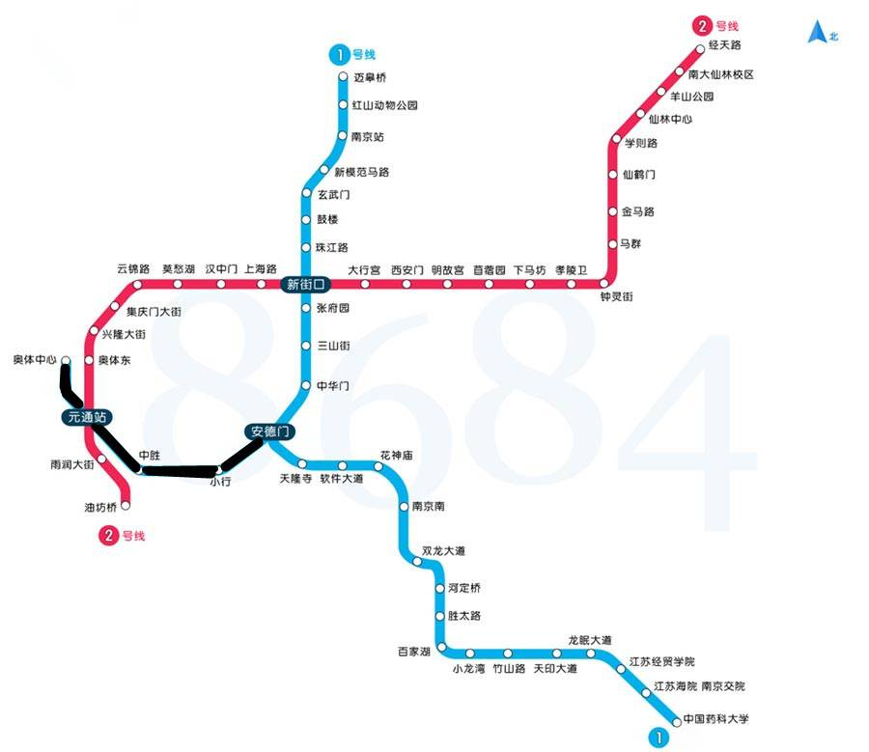
What is this course about?
Managing Complexity
Mastering Abstraction

Slide 5
What is this course about?
Managing Complexity
Mastering Abstraction
Programming Paradigms
Introduction to Programming
Full understanding of Python fundamentals
Combining multiple ideas in large projects
How computers interpret programming languages
A challenging course that will demand a lot from you

Slide 6
Alternative to this course
程序设计基础
Programming in C
Similar goals, different textbooks and languages

Slide 7
Course Format
Lecture
MW 14:00 -15:50，仙II-503
Lab section
Th 16:00 – 18:00，基础实验楼 乙124
Office hours
M 19:00 – 21:00
Course webpage
https://cs.nju.edu.cn/xyfeng/teaching/SICP
Online textbook
https://composingprograms.com
homework assignments
programming projects
A midterm and a final
Lots of course support

Slide 8
Grading
Homework, 15%

Slide 9
Homeworks
Will be graded on “effort”
This approximately means, completing most of the problems and at least attempting to solve the rest
This means there’s no reason to cheat!
Ask for help if you are stuck and make a good effort on all of the homework

Slide 10
Grading
Homework, 15%
Labs, 10%
Graded on correct completion
Need to complete in the lab section
Projects, 25%

Slide 11
Projects
Will be graded on correctness and composition
Several of the programming projects will be partnered
Larger than homeworks

Slide 12
Grading
Homework, 15%
Labs, 10%
Projects, 25%
Midterm, 25%
Final, 25%

Slide 13
Collaboration
We highly encourage discussing / sharing ideas with each other
Limitations
Do not share code
The only circumstance in which a student should be looking at another student's code is if they are project partners

Slide 14
Expressions

Slide 15



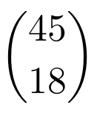



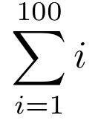

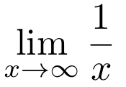


Types of Expressions
An expression describes a computation and evaluates to a value

Slide 16
Call Expressions in Python
All expressions can use function call notation
Demo

Slide 17
Anatomy of a Call Expression
add ( 2 , 3 )
Operator
Operand
Operand
Operators and operands are also expressions

Slide 18
Evaluation of a Call Expression
add ( 2 , 3 )
Operator
Operand
Operand
Evaluate
Evaluate the operator subexpression
Evaluate each operand subexpression
Apply
Apply the value of the operator subexpression to the values of the operand subexpression

Slide 19
add(add(6, mul(4, 6)), mul(3, 5))

Slide 20
Humans
We like to inside inside-out
add(add(6, mul(4, 6)), mul(3, 5))
add(add(6, 24 ), mul(3, 5))
add(add(6, 24 ), mul(3, 5))
add( 30 , mul(3, 5))
add( 30 , mul(3, 5))
add( 30 , 15 )
add( 30 , 15 )
45
Python can’t jump around in the same way we do

Slide 21
Nested Call Expression
Evaluate operator Evaluate operands Apply!
1
2
3
45
add(add(6, mul(4, 6)), mul(3, 5))
add
30
15
add(6, mul(4, 6))
mul(3, 5)
24
add
6
mul(4, 6)
mul
3
5
mul
4
6
Expression Tree

Slide 22
Functions, Values, Objects, Interpreters and Data
Demo

